Slide 1

MapReduce
Mohd Hasnain - MCHD - MapR Certified Hadoop Developer
(550574 | Mobile: +91 987 173 4819 )

Slide 2
Google WP - Jeffrey Dean and Sanjay Ghemawat
map(String key, String value):
// key: document name
// value: document contents
for each word w in value:
EmitIntermediate(w, "1");
reduce(String key, Iterator values):
// key: a word
// values: a list of counts
int result = 0;
for each v in values:
result += ParseInt(v);
Emit(AsString(result));

Slide 3
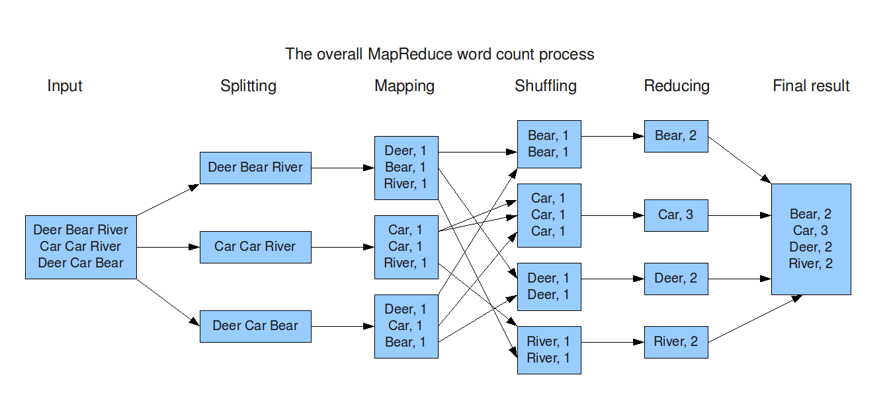
DATA FLOW

Slide 4
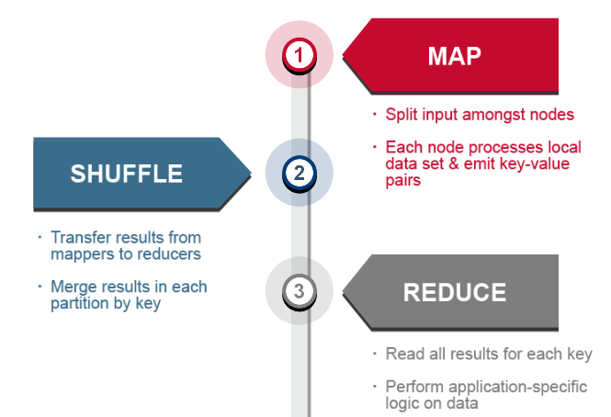
MapR Process

Slide 5
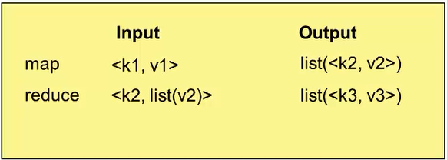
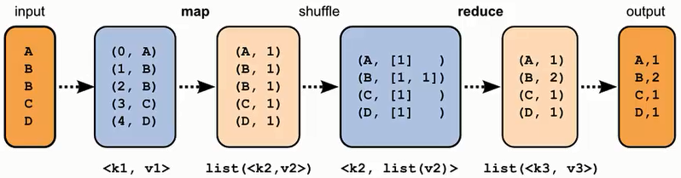

Slide 6
How MapReduce Works? - Classic MapReduce
4 independent entities:
  Client
  JobTracker
  TaskTracker – fixed no of slots for map/reduce
  HDFS
Data/rack local – not for reduce task

Slide 7
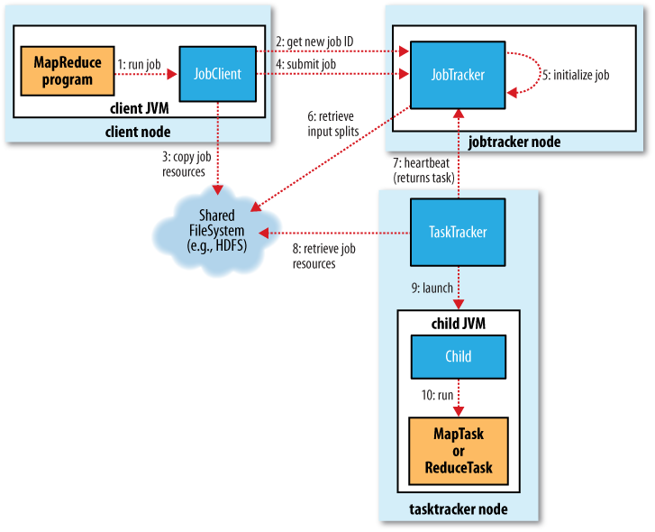

Slide 8
Progress and Status Updates
Map tasks
  This is the proportion of the input that has been processed
Reduce tasks
  1/3 for copy, sort, reduce
  task has run the reducer on half its input
  = 2/3 + 1/3 = 83%
Heartbeat every few seconds
getStatus() by Clients
Speculative Execution

Slide 9
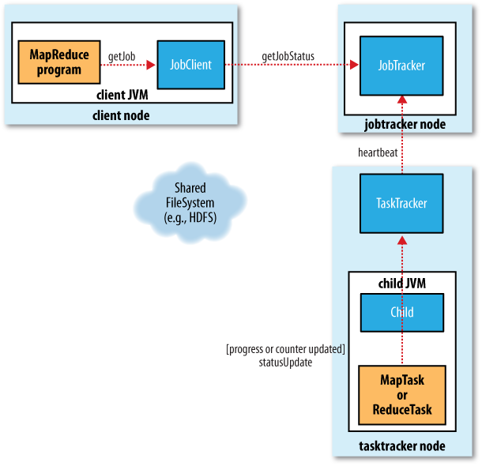
How status updates are propagated through the Classic system

Slide 10
YARN - Yet Another Resource Negotiator
Limitations of MRv1 – Motivation for YARN
Scalability – Single JT – SPOF
  max 4000 nodes per cluster
  YARN equivalent of JT has multiple instances per cluster
Under/Over usage of resource
  Map and Reduce slots configuration is not dynamic, it is fixed
  No slot in YARN
No support for non-MR job – YARN support both
Not optimize for job scheduling
Uber task in YARN
YARN uses same API/CLI/Web UI as MRv1
Separation of Recourse and Job Management, both were handle by JT

Slide 11
Entities in YARN
Client
Resource Manager
  Cluster Resourcing – creates/deletes container
  Job Scheduling – Tracks Node Managers
Node Managers
  launch and monitor the compute containers
  Container = Logical envelop of resource (CPU + Memory)
Application Master
  Resource Negotiation
  Job Monitoring
HDFS/distributed Cache

Slide 12
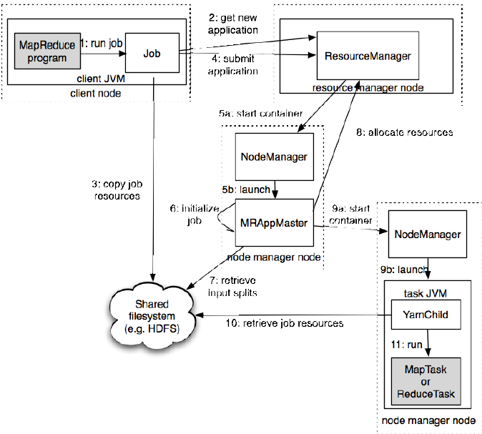

Slide 13
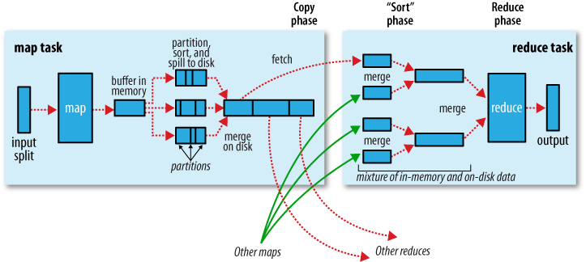
Shuffle and sort

Slide 14
MapReduce program consists 3 parts :
  Driver
  Mapper
  Reducer
Framework makes guarantee that input to every reducer is sorted by key
Shuffle – most time consuming, give more memory as much possible
Compress Map o/p saves disk space and N/W BW
Reducer SORT is actually Merge Phase ???
Merge the min no of files to get merge factor (io.sort.factor) in final round – Optimization
Io.sort.mb = default 100 MB = Memory buffer to use while sorting map output
Partitioning is done by Hash Function

Slide 15
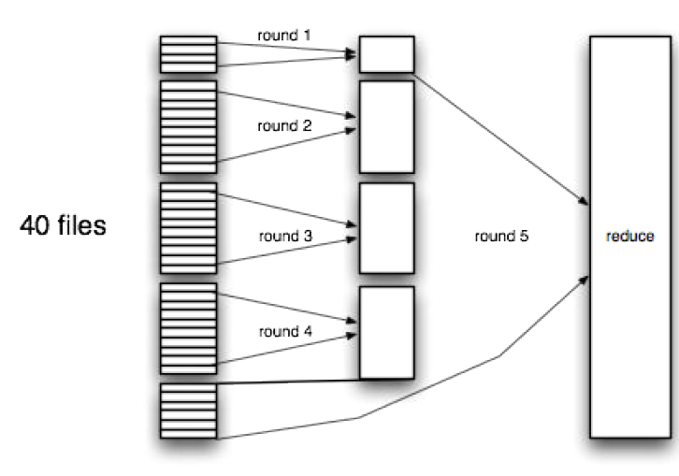
Efficiently merging 40 file segments with a merge factor of 10

Slide 16
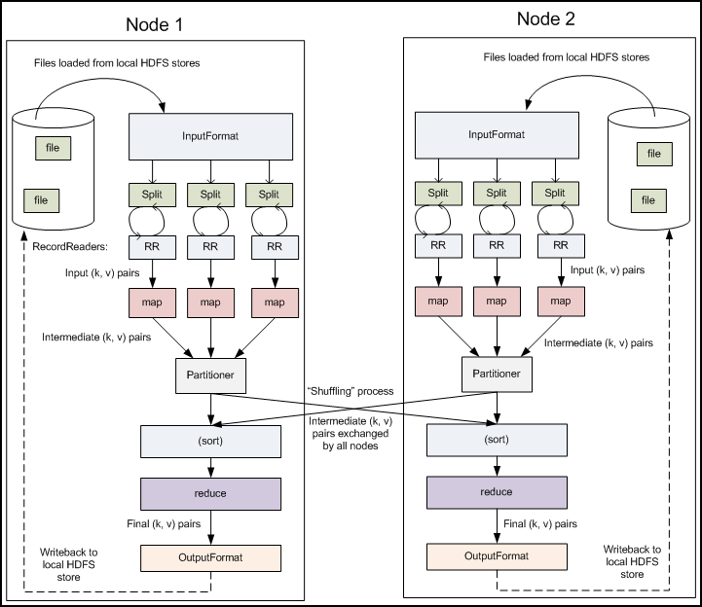

Slide 17
RecordReader
InputSplit has defined a slice of work, but does not describe how to access it.
RR class actually loads the data from its source and converts it into (key, value) pairs suitable for reading by the Mapper.
RR instance is defined by the InputFormat. The default is TextInputFormat
The key associated with each line is its byte offset in the file.

Slide 18
Driver
The Driver code runs on the client machine and is responsible for building the configuration of the job and submitting it to the Hadoop Cluster. The Driver code will contain the main() method that accepts arguments from the command line.
common libraries:
import org.apache.hadoop.fs.Path;
import org.apache.hadoop.io.*;
import org.apache.hadoop.mapred.*;
The JobConf class allows you to configure the different properties for the Mapper, Combiner, Partitioner, Reducer, InputFormat and OutputFormat.

Slide 19
public class MyDriver{
public static void main(String[] args) throws Exception {
// Create the JobConf object
JobConf conf = new JobConf(MyDriver.class);
// Set the name of the Job
conf.setJobName(“SampleJobName”);
// Set the output Key type for the Mapper
conf.setMapOutputKeyClass(Text.class);
// Set the output Value type for the Mapper
conf.setMapOutputValueClass(IntWritable.class);
// Set the output Key type for the Reducer
conf.setOutputKeyClass(Text.class);
// Set the output Value type for the Reducer
conf.setOutputValueClass(IntWritable.class);
// Set the Mapper Class
conf.setMapperClass(MyMapper.class);
// Set the Reducer Class
conf.setReducerClass(Reducer.class);
// Set the format of the input that will be provided to the program
conf.setInputFormat(TextInputFormat.class);
// Set the format of the output for the program
conf.setOutputFormat(TextOutputFormat.class);
// Set the location from where the Mapper will read the input
FileInputFormat.setInputPaths(conf, new Path(args[0]));
// Set the location where the Reducer will write the output
FileOutputFormat.setOutputPath(conf, new Path(args[1]));
// Run the job on the cluster
JobClient.runJob(conf);
}
}

Slide 20
Word counting using MapReduce - Hello,World program for MapReduce
For this example let us consider the following input:
she sells sea shells on the sea shore
Mapper for Word Count
Reducer for Word Count
Driver for Word Count

Slide 21
package wordcount;
import java.io.*;
import java.util.*;
import org.apache.hadoop.io.*;
import org.apache.hadoop.mapred.*;
public class WordCountMapper extends MapReduceBase implements Mapper<LongWritable, Text, Text, IntWritable>{
public void map(LongWritable key, Text value, Context Context) throws IOException {
StringTokenizer st = new StringTokenizer(value.toString().toLowerCase());
while(st.hasMoreTokens()) {
output.collect(new Text(st.nextToken()), new IntWritable(1));
}
}
}

Slide 22
Map o/p
When the Mapper receives this line each and every word of the sentence is broken down into <key, value> pairs.
So, for the input line the following <key, value> pairs will be generated:
<she,1>
<sells,1>
<sea,1>
<shells,1>
<on,1>
<the,1>
<sea,1>
<shore,1>

Slide 23
package wordcount;
import java.io.*;
import java.util.*;
import org.apache.hadoop.io.*;
import org.apache.hadoop.mapred.*;
public class WordCountReducer extends MapReduceBase implements Reducer<Text, IntWritable, Text, IntWritable>{
public void reduce(Text key, Iterator<IntWritable> values, Context Context) throws IOException {
int count = 0;
while(values.hasNext()) {
count += values.next().get();
}
output.collect(key, new IntWritable(count));
}
}

Slide 24
Reducer O/P
The reducer receives all the key value pairs for in the sorted order of the key. As you can see above the reduce method takes in all <key, value> pairs and increments a counter for values with the same key and emits it out. So the output of the reducer will be as follows:
<on, 1>
<sea, 2>
<sells, 1>
<she, 1>
<shells, 1>
<shore, 1>
<the, 1>

Slide 25
package wordcount;
import java.io.*;
import org.apache.hadoop.fs.*;
import org.apache.hadoop.io.*;
import org.apache.hadoop.mapred.*;
import org.apache.hadoop.util.*;
import org.apache.hadoop.conf.*;
public class WordCount extends Configured implements Tool{
public int run(String[] args) throws IOException{
JobConf conf = new JobConf(WordCount.class);
conf.setJobName("wordcount");
conf.setOutputKeyClass(Text.class);
conf.setOutputValueClass(IntWritable.class);
conf.setMapperClass(WordCountMapper.class);
conf.setReducerClass(WordCountReducer.class);
conf.setInputFormat(TextInputFormat.class);
conf.setOutputFormat(TextOutputFormat.class);
FileInputFormat.setInputPaths(conf, new Path(args[0]));
FileOutputFormat.setOutputPath(conf, new Path(args[1]));
JobClient.runJob(conf);
return 0;
}
public static void main(String[] args) throws Exception {
int exitCode = ToolRunner.run(new WordCount(), args);
System.exit(exitCode);
}
}

Slide 26
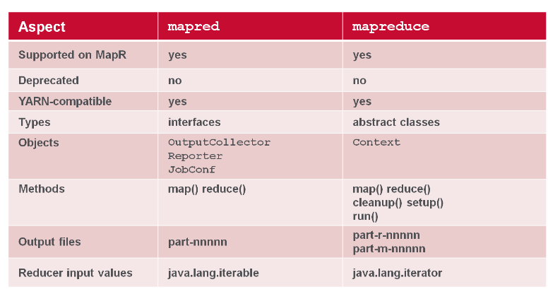

Slide 27
hadoop ecosystem
- CDH ( Cloudera Distribution Including Apache Hadoop)
Sqoop – RDBMS to HDFS
Flume – Instream to HDFS – example logs
Hive – SQL like – Runs MapR
Pig – Script – Runs MapR
Oozie – Task Mangement
Mahout – M/c learning on Hadoop
Drill/Impala - Low latency query – Directly HDFS
HBase is inspired from Google’s BigTable. It is a non-relational, scalable and fault-tolerant database that is layered on top of HDFS. HBase is written in Java.
ZooKeeper is a centralized service for maintaining configuration information, naming, providing distributed synchronization, and providing group services

Slide 28
